Slide 1
Storyboard
Hospitality

Slide 2
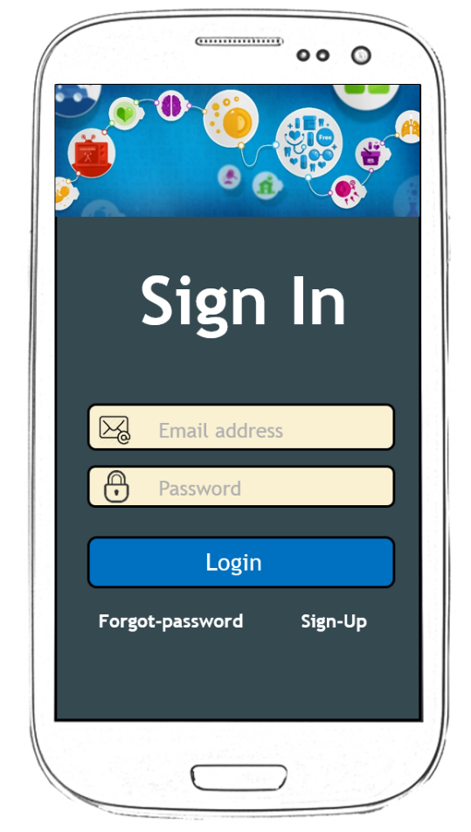
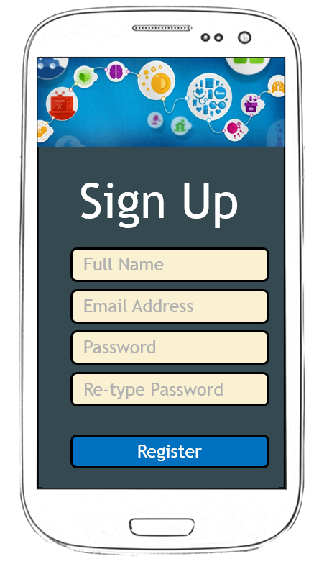
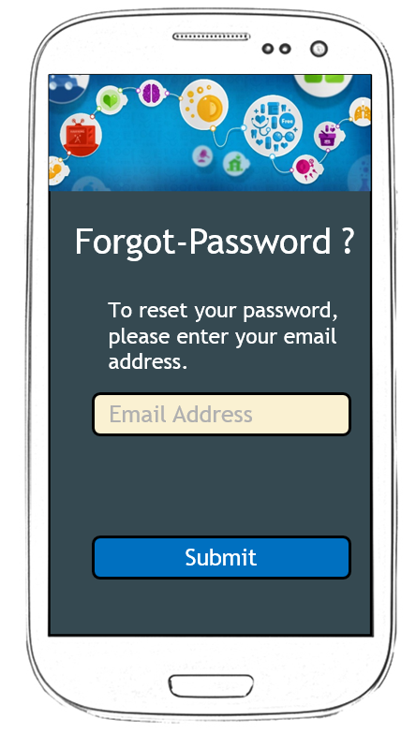
Sign In, Sign Up and Forgot Password Screen

Slide 3














Loading screen and Home Screen
Home
Home
Profile
Find Services
Loading ..
Remainders
Appointments
Call for help
Useful Links
Send Feedback
About the app

Slide 4






Profile
Change Picture
Jomin George
Last Login: Thursday, February 29, 2016, 15:20:13
Gender
Language
Email Address
Contact Number
Done

